Slide 1

The German Partnership for
Sustainable Mobility (GPSM)
…is your guide for sustainable mobility and green logistics solutions and knowledge from Germany.
…is a reliable and inspiring network which offers access to knowledge, experts, and networking events on sustainable mobility and green logistics.

Slide 2
Sustainable Mobility –
Made in Germany
… stands for sustainable, proven, resource efficient, innovative, trustworthy and flexible solutions for all domains of mobility and logistics services.
… stands for a long history of successful changes and transformations in the transport sector. This requires constant learning from setbacks. We continuously adapt solutions and improve decision-making processes.
… stands for high class public transport systems, comprehensive approaches to support walking and cycling, worldwide championship in logistics as well as improving road safety.
Notes:
“Sustainable Mobility - Made in Germany” stands for sustainable, proven, resource efficient, innovative, trustworthy and flexible solutions for all domains of mobility and logistics services.
Germany has a long history of successful changes and transformations in the transport sector – including
the establishment of comprehensive funding schemes,
the re-emergence of walking and cycling as safe and viable modes of transit,
the reorganization of the public transport sector,
the continuous development of progressive regulations,
the development of efficient propulsion systems,
the integration of different modes of transport, including multimodality in logistics.
Academia, businesses, civil society and associations have gathered invaluable experiences and skills in framing these transformations.
The German experience is worth of study. Due to the scarcity of energy resources, the high density of people and enterprises, as well as the compactness of the country, Germany opted early on for energy-efficient, integrated and smart solutions in the transport sector.
… stands for worldwide championship in logistics, highest ambitions in making our public transport services even more attractive and implementing smart mobility innovations.
… stands for comprehensive approaches to support walking and cycling as as well as significant success in improving road safety during the last decades.

Slide 3

Clean Air –
Made in Germany
Explore our new publication
Download free of charge at:
www.german-sustainable-mobility.de/cleanair

Slide 4
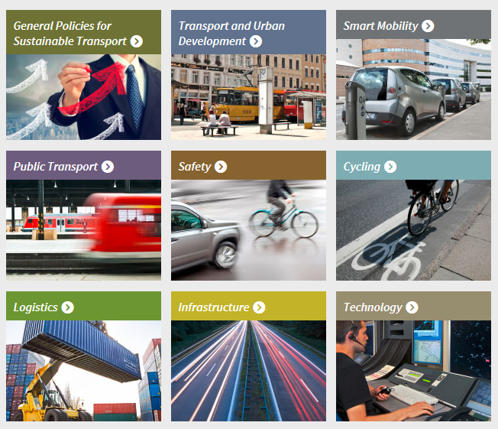



Clean Air –
Made in Germany
Explore sustainable mobility and logistics - Made in Germany:
www.german-sustainable-mobility.de
Get in contact:
contact@german-sustainable-mobility.de
On behalf of
Supported by

