Slide 1
Legal and regulatory challenges in the use of multi-purpose electric infrastructure
3rd ELIPTIC webinar
9 April 2018
Hartwig von Bredow
1
Notes:
PT electric infrastructure is new interface between energy and mobility systems
Legal study conducted by law firm von Bredow Valentin Herz

Slide 2
Overview
Introduction
Opening up the black box
New market roles and their legal implications
Energy storage and regenerative braking
Policy Recommendations
2
Notes:
Challenge 1: exposure to multiple taxation
Challenge 2: discounted vs. non-discounted energy consumption
Challenge 3: new market roles and administrative requirements for PT operators
Challenge 4: Energy regulation and PT grids

Slide 3
Overview
Introduction
Opening up the black box
New market roles and their legal implications
Energy storage and regenerative braking
Policy Recommendations
3
Notes:
Challenge 1: exposure to multiple taxation
Challenge 2: discounted vs. non-discounted energy consumption
Challenge 3: new market roles and administrative requirements for PT operators
Challenge 4: Energy regulation and PT grids

Slide 4
Introduction I
PT grid is used for multiple purposes
  Rail-bound public transport
  E-mobility
    PT Company uses battery operated electric busses
    PT Company or third parties install public charging stations
  Energy storage (battery storage and flywheel storage)
  Electricity recovered by regenerative braking is fed into the PT grid
  Interactions between PT Grid and public electricity grid
4

Slide 5
Introduction II
Use of multipurpose electric infrastructure means to connect the energy sector and the public transport sector
It seams unclear if current energy law is suitable to properly rule out the interface between these two sectors
  Legal uncertainties & risks
  Complex and sometimes excessive requirements (reporting, measurement, energy regulation)
  exposure to multiple taxation
5
Notes:
All of this may hamper innovative e-mobility services offered by PT companies

Slide 6
Overview
Introduction
Opening up the black box
Energy storage and regenerative braking
Policy Recommendations
6
Notes:
Challenge 1: exposure to multiple taxation
Challenge 2: discounted vs. non-discounted energy consumption
Challenge 3: new market roles and administrative requirements for PT operators
Challenge 4: Energy regulation and PT grids

Slide 7

Current practice:
PT grid as black box
Assumption:
PT operator is final consumer
of electricity
7

Slide 8
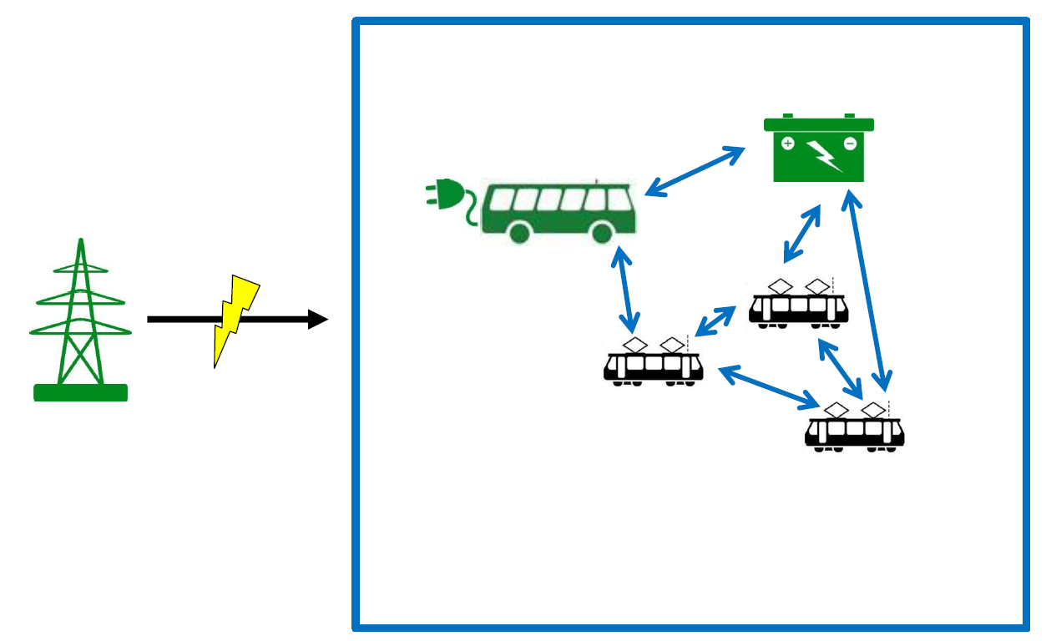
Opening up the black box
8
Notes:
Law does not assume energy generation within energy consumption black box such as regenerative braking or energy buffering with stationary batteries

Slide 9


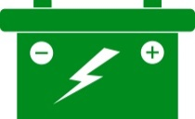



future e-mobility requirements
→ there is no “blackbox” anymore
Further consumption (tram stations, escalators, etc.)
9
Notes:
Energy law does not expect any energy to come back out of the consumption black box

Slide 10
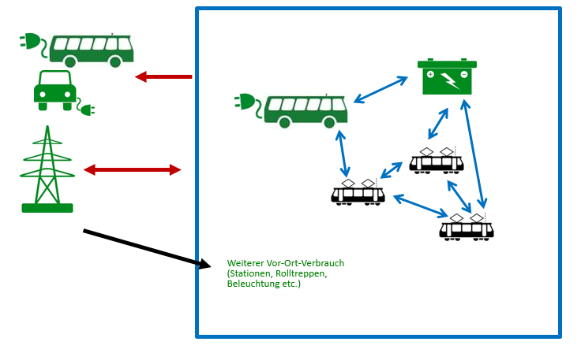
Legal questions and challenges
Is there a suitable legal framework for
energy storage?
Recovery and use of brake energy?
Charging e-busses and other electric vehicles with electricity taken from the PT Grid?
Selling of electricity to third parties?
Feeding recovered brake energy and energy taken out of storage facilities into the public electricity grid?
New challenges:
How can PT operator distinct the different processes of energy consumption and energy generation?
Set up of a coherent metering concept
Distinction between discounted electricity consumption and non-discounted energy consumption
How can PT operator avoid multiple taxation and levies?
New market role for PT operators: 1. energy utility and 2. operator of a general supply network (that may underly regulation and supervision)
Interactions between PT grid and public electricity network
10
Notes:
Challenge 1: exposure to multiple taxation
Challenge 2: discounted vs. non-discounted energy consumption
Challenge 3: new market roles and administrative requirements for PT operators
Challenge 4: Energy regulation and PT grids

Slide 11
Overview
Introduction
Opening up the black box
New market roles and their legal implications
Energy storage and regenerative braking
Policy Recommendations
11

Slide 12
New market role: operator of a public distribution network
Current legal status of PT grids seems unclear
  customer system for the company's own supply?
  … untouched by energy regulation
If PT grid becomes a public distribution network, energy regulation applies
  Obligations towards other stakeholders (e.g. granting of grid access, transparency, no discrimination)
  Network charges
  Reporting obligations
  And so on...
12

Slide 13

New market role: electricity supplier
Obligation to pay EEG levy
Compulsory registration at the network operator
Electricity tax: Compulsory registration at the main customs office
Further regulations apply to suppliers
concerning electricity labeling, accounting, contracts, etc.
Electricity fed into the public electricity network
  Balancing
  Grid services
  Power purchase agreement / exchange authorization
13

Slide 14
Overview
Introduction
Opening up the black box
New market roles and their legal implications
Energy storage and regenerative braking
Policy Recommendations
14

Slide 15
Challenge: regenerative braking
Brake energy recovery
  Trams generate electricity by recuperation / brake energy recovery
  Recovered electricity is either used in the tram (heat) or gets fed into the PT grid (and then consumed by other trams)
Legal questions
  Do trams classify as electricity-generating units?
  If so, what legal stipulations apply to the electricity generated by recuperation? (self supply, EEG levy, multiple taxation)?
  Can trams be considered „kinetic storage facilities“ in order to apply Section 61k EEG 2017 and avoid multiple exposure to EEG levy? If so, how does this work (measurement concept, accounting, conversion losses)?
15

Slide 16
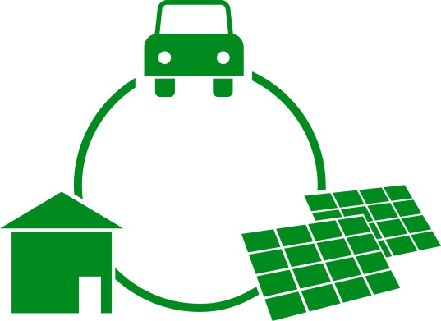
Intoducing: EEG levy for the consumption of energy
2018: 6.792 Cent per kWh
General principle: 100 percent of EEG levy for each kWh of electricity consumed within Germany
Applies for any energy comsumption, even for the consumption of energy that is not taken from the
electricity grid
Some exemptions and limitations in case of self-supply, no exemptions for delivery
Limitation of EEG levy for railways
    Only applies to „electricity that was consumed
    directly for the railway transport operation“
    Energy consumption of at least 2 GWh
    Limitation to 20 per cent
  Two main challenges:
    Avoid multiple exposure to EEG levy
    Distinguish discounted from non-discounted energy consumption
16

Slide 17
EEG levy for 2.000 or for 3.500 kWh?
500 kWh
500 kWh
1.000 kWh
PT Grid
2.000 kWh
1.000 kWh
1.000 kWh
500 kWh
1.000 kWh
500 kWh
500 kWh
Escalators etc.
250 kWh
250 kWh
250 kWh
17

Slide 18
Overview
Introduction
Opening up the black box
New market roles and their legal implications
Energy storage and regenerative braking
Policy Recommendations
18

Slide 19
Policy recommendations for multi-purpose electric PT infrastructure
Need for a clear framework that regulates the role of public transport operators working on the intersection of mobility and energy:
Clarity about requirements
PT operators should not face risk to lose public subsidies
New e-mobility related technologies and applications need to be covered by energy law (energy storage, recuperation, etc.) without excessive measurement requirements
Reduce complexity of legal requirements
19
Notes:
legal framework needs to be suitable and coherent.
On the one hand, the legal framework has to represent the specific role of e-mobility within in the energy system.
On the other hand, governments have to reduce legal uncertainties and the complexity of legal stipulations

Slide 20
Thank you very much for your attention!
Dr. Hartwig von Bredow
Rechtsanwalt
von Bredow Valentin Herz
Partnerschaft von Rechtsanwälten mbB
Littenstraße 105
10179 Berlin
T: +49 30 8092482-20
F: +49 30 8092482-30
vonbredow@vbvh.de
www.vonbredow-valentin-herz.de
20

