Slide 1




ELIPTIC
EBERSWALDE
LONDRES
BREMEN
Planning a charging infrastructure for electric vehicles using Barcelona’s rail network
Eliptic Project
GDYINIA (2)
BRUSEL·LES
LEIPZIG
VARSOVIA
OBERHAUSEN
SZEGED
BARCELONA
LANCIANO
April 9 2018

Slide 2


ELIPTIC – Electrification of public transport in cities
ELIPTIC expects that the future of the electric mobility can be reinforced integrating them in the existing electric public transport infrastructure
Pillar A
Pillar B
Secure integration of e–buses into the existing electric public transport infrastructure
Actualization or regeneration of the public electric transport to improve the operative efficiency
Pillar C
Multiple use of the electric public transport infrastructure
33 partners in 8 countries
Research and Innovation project Horizon 2020
36 months duration:
01.06.2015 - 30.05.2018
Budget: 5,9 Million EUR

Slide 3
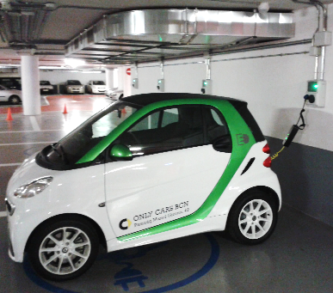
Why ELIPTIC for Barcelona?
Contribution to create a more sustainable city, decreasing the greenhouse gases and noise pollution to improve the citizens quality of life.
Increase the resilience of the city optimizing the energy use between the railway operator and B:SM car parks for charging purposes.
B:SM wants to supply the electric charging service for the citizens in an efficient and effective way.

Slide 4
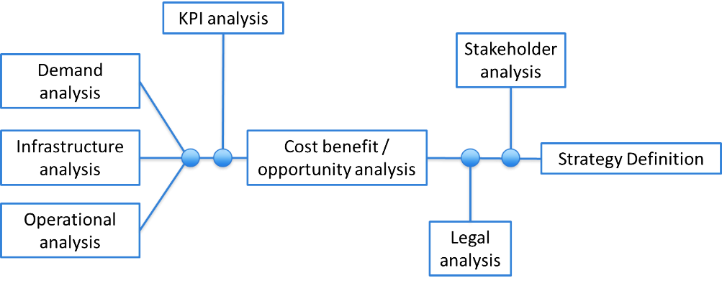
ELIPTIC. Pillar C – B:SM
Eliptic Pillar C Barcelona has the objective to carry out a viability study to prove the convenience of the electric car charging network implementation in B:SM car parks connected to the railway electric infrastructure.
Analysis of the necessary elements for the connection with the electrical Railway network, capacity and demand
INFRASTRUCTURAL
OPERATIONAL
Analysis of the infrastructural business model and resolution of barriers (operative and legal)
STRATEGICAL
Strategic Implementation plan linked with the skateholders

Slide 5

Planning the distribution of charging points in the city
Steps followed:
1. Analyse the requirements to connect charging points to the railway grid
Taxi parking areas (taxi stops)
Areas for loading/unloading of goods for urban freight vehicles
2. Analyse all parking areas of the city
Regulated Surface parking areas (resident and non-resident areas)
3. Analyse the use (occupation) of the different areas
BSM underground parkings (both season holder and pay per use)
4. Distribute the forecasted charging points needed taking into consideration:
The demand of each parking area
The spatial coverage of the city
The proximity to railway lines in order to connect them to their grid
3

Slide 6
Requirements to connect charging points to the railway grid
Area in which a charging station could be connected to the railway grid
As an approximation, the area to which the charging points could be potentially connected has been calculated taking into account the cost of installation of the cable, both on-street and in gallery (undergrounded) looking for the minimum distance between a feeder substation and recharging points.

Slide 7
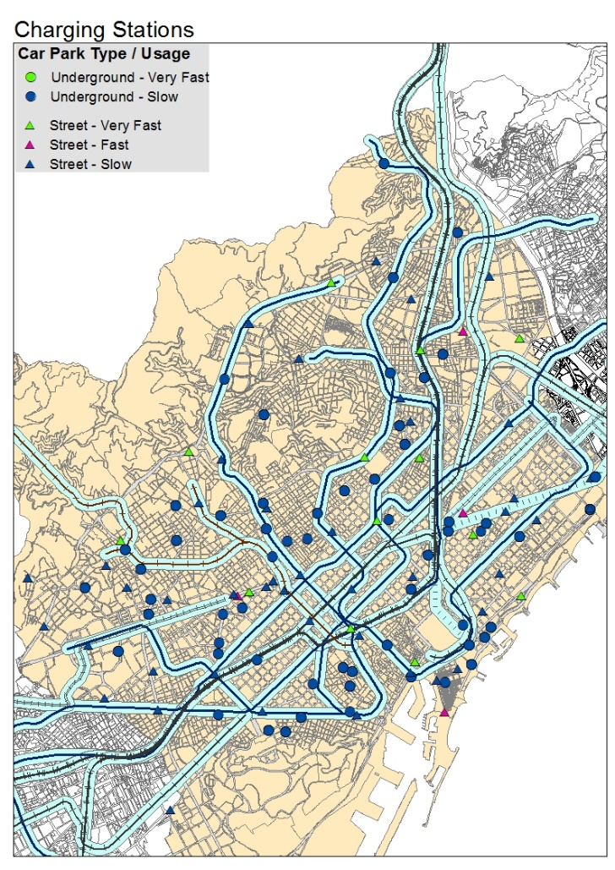
Current number of charging points in the vicinity of railway lines
The map shows the current railway lines and the existing charging points for different segments of users:
Underground fast chargers
On-street fast charge
On-street motorbike
On-street freight vehicles
On-street taxis
Currently (may 2017), 42 out of 125 charging stations fall in the area of influence of railway lines (metro, tram, railway).
3

Slide 8
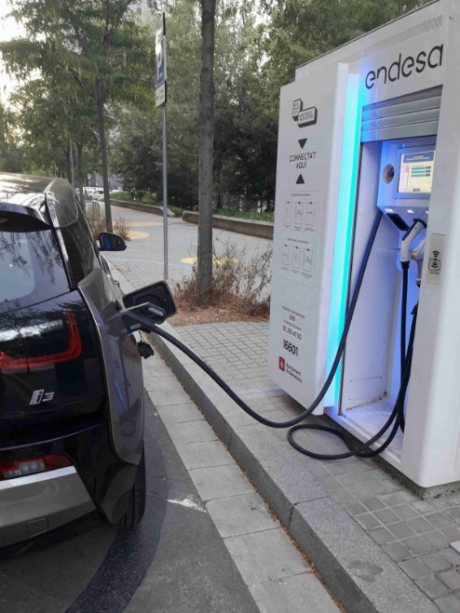
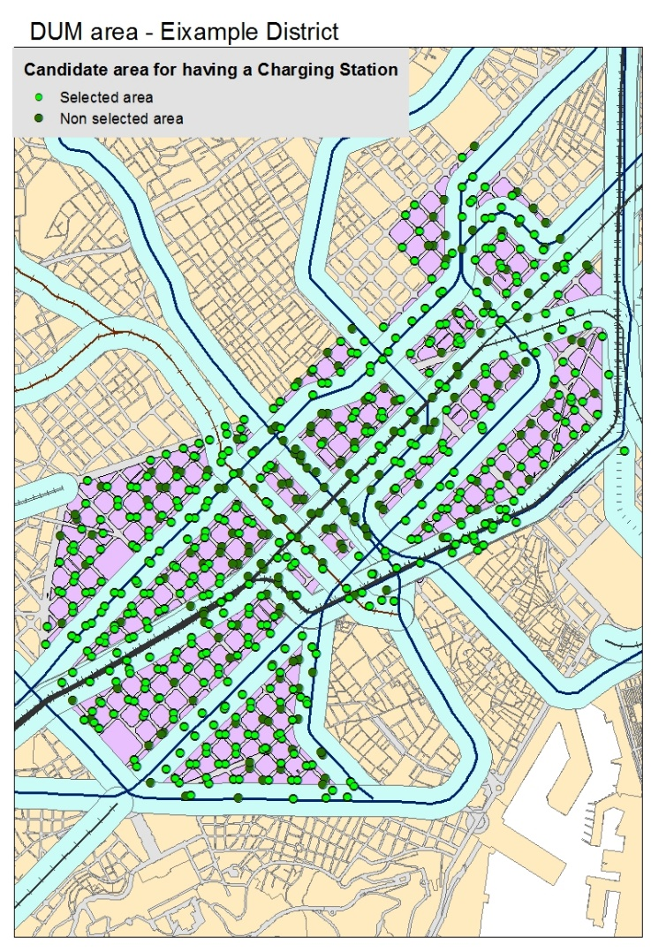
Distribution of the forecasted charging stations in the city
To distribute the charging stations in the different parking areas several requirements have been considered:
Uniformity in the urban areas
Density of the different parking areas
High use of the parking areas
Distance to the railway grid
The figures obtained allow that in a second stage, city council technicians decide in detail the exact location of the charging stations considering further requirements as well as ensuring a high use of them.

Slide 9
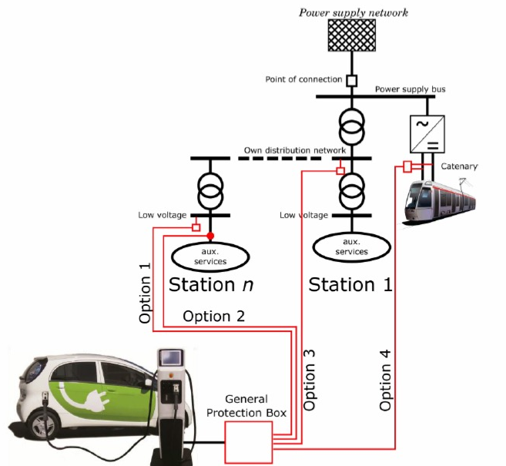
ELIPTIC. Pillar C – Infrastructure analysis
Four connection modes have been technically identified, described and defined:
Connecting AC to the station 420 V on transformer bars.
Connecting AC 420 V on the station auxiliary services line.
Connecting AC 420 V on the substation transformer bars.
Connecting DC 750-1500V directly from the catenary.
The investment and maintenance cost has been described through cost drivers based on basic units of cost (distance from the tunnel, devices needed…).
The connection chosen due to functional and economical feasibility has been the option 3.

Slide 10
ELIPTIC. Pillar C – Infrastructure growth
ELECTRIC CHARGER TYPES
EXPANSION OF THE PARKING NETWORK NEED
Slow and fast charging points, to provide a flexible service (on-street)
Slow charging points, which are the only ones currently used at B:SM car parks (off-street)
It includes the current parking lots, the off-street growth and the on and off-street growth
MANAGEMENT MODEL
RAILWAY NETWORK POWER USAGE
Agreement between rail operator and B:SM management
Exclusive Railway Operator management
Exclusive B:SM management or allowing the utility to be the network operator.
BSM will use its parking lot energy supply constantly or dynamically.

Slide 11
1 electricity sale
2 electricity sales
ELIPTIC. PILLAR C – Operational analysis
Alternative scenarios
Scenario 1
Scenario 3
Public
B:SM pays the Railway Operator for the electricity.
B:SM charge its own public fleet.
B:SM pays the Railway Operator for the electricity.
Public fleets pay B:SM for charging their fleets.
USE
Scenario 2
Scenario 4
Private
Final client pays the Railway Operator for the charge.
Final client pays B:SM for the parking slot.
B:SM pays the Railway Operator for the electricity.
Final private client pays B:SM.

Slide 12


1 electricity sale
2 electricity sales
ELIPTIC. PILLAR C – VIABILITY
Scenario 1
Scenario 3
Public
Legal Viability
Infrastructural* Viability
Operational Viability
Legal Viability
Infrastructural* Viability
Operational Viability
USE
Scenario 2
Scenario 4
Private
Legal Viability
Infrastructural* Viability
Operational Viability
Legal Viability
Infrastructural* Viability
Operational Viability
* It depends on the location of the railway substations. If it is closer than 300m to the car park then it’s viable if it’s further it is not viable.

Slide 13
  SWOT Analysis

Slide 14
FEASABILITY ANALYSIS CONCLUSIONS
Infrastructure design and installation report
Demand analysis report
300 meters is the maximum recommended distance between the rail network and the recharging point. Each point should have its own study.
Recommended AC 420 V connection on the substation transformers bars.
Plan a scalable network growth involving the main stakeholders considering the impact in the social cost and plan the usage of an alternative power source when PT peak time through a competitive management model
Key variables to locate of resilient or non-resilient charging points: uniformity of supply, density and occupation of car parks. The charging point nominal power depends on the users and areas of the city, on-street and off-street should be differentiated.
Due to EV growth, by 2020, the total number of charging points needed to supply the demand will be 331 charging points.
Operational model definition report
Legal report
Power usage during daytime could be a combination of the maximum PT excess energy and other sources. During night-time, the charging system could benefit completely from PT due to rail services schedule.
The charging manager is the only part able to sell energy. This role can be done by the PTO or by the car park manager, this is not only important in financial terms but also has consequences on the maintenance responsibilities.
Actual Spanish decrees and regulations have been taken into account, looks likely they’re going to be more open, so there will be more opportunities.
Currently the most likely scenarios to be approved are the ones when there is only one charging manager (PTO to car park manager) and the end user is related to the public administration

Slide 15
ELIPTIC. PILLAR C – B:SM CHARGING MANAGER STRATEGY
Ensure the infrastructure legalization following the Art. 1 Real Decret 647/2011, May 9th
Introduce improvements in the regulatory framework and in the public politics to boost the e-mobility
Motivate public social services to use a 100% electric fleet. Make the demand increase.
Give value to the infrastructure and setting up a price for the charge
Line-up with the principal players in the electro mobility area
Work for the sustainable network growth based on the urban resilience and the search of alternative energy distribution network.

Slide 16

Thank you for your attention
EBERSWALDE
LONDRES
BREMEN
GDYINIA (2)
BRUSEL·LES
LEIPZIG
VARSOVIA
OBERHAUSEN
SZEGED
BARCELONA
LANCIANO

