Slide 1
Planning for People ©
Who we are and what we do.
Rupprecht Consult – Forschung & Beratung GmbH, Cologne

Slide 2
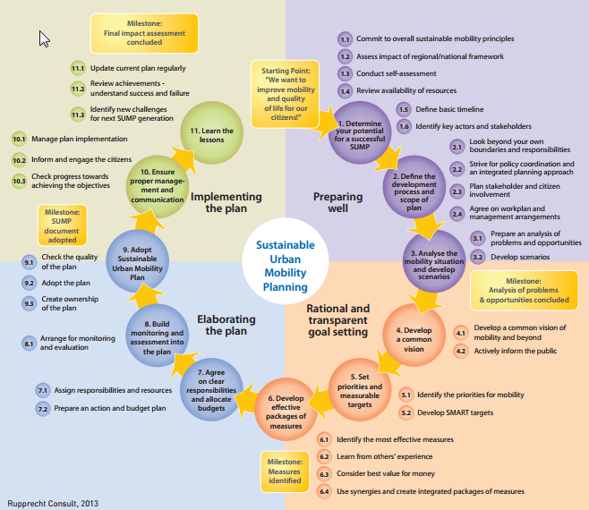
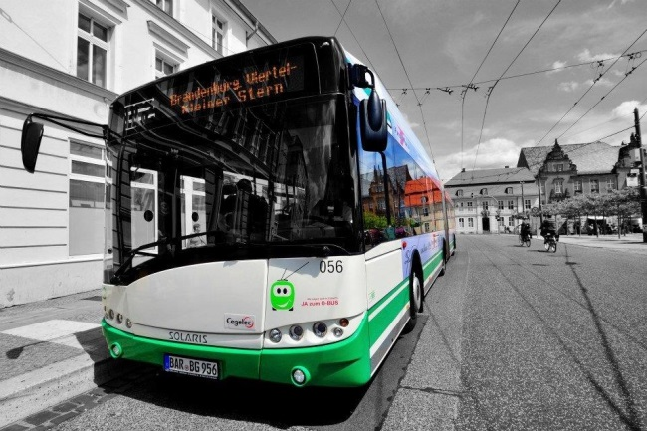
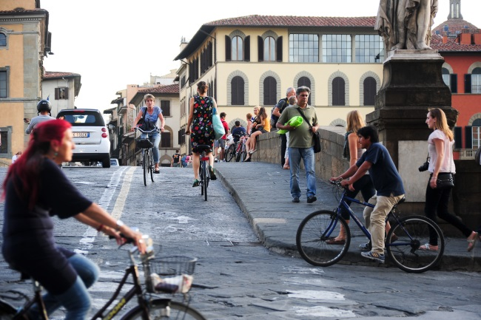
Our Themes
Integrated Planning
  Sustainable Urban Mobility Planning (SUMP)
  Governance & stakeholder cooperation
  Urban and regional plan preparation
  Development of Urban Nodes in the TEN-T
Collective and Intelligent Mobility
  Public transport innovation
  Electromobility strategies
  Connected Intelligent Transport Systems (C-ITS)
  Automation of urban mobility
People-focussed Mobility Solutions
  Integrated mobility solutions
  Sustainable life styles
  Active mobility
  Community-based innovation
SUMP planning cycle, Rupprecht Consult
Trolley bus, Eberswalde
A prime knowledge partner in sustainable urban mobility innovation
Mobility mix

Slide 3
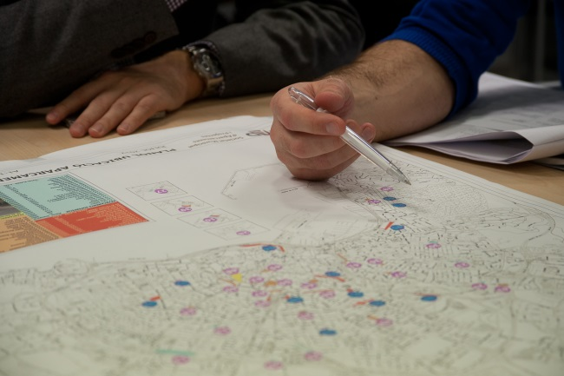
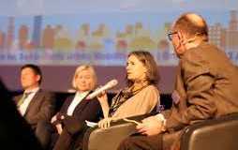
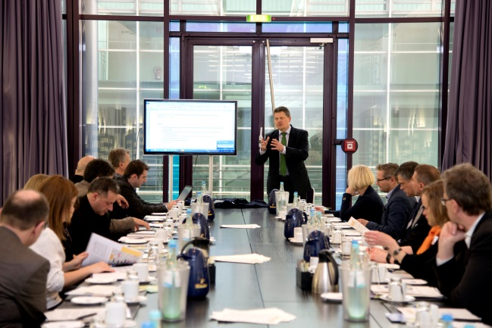
Our Services
Project development
Project management
Evaluation, monitoring,
socio-economic analyses
Consultation processes and network management
Strategic policy development
Learning and knowledge transfer
Planning workshop, Palma
SUMP Conference 2016, Bremen
Supporting innovative ideas through concrete projects
Stakeholder meeting, Bremen

Slide 4
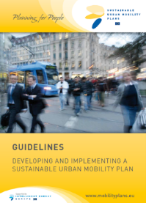
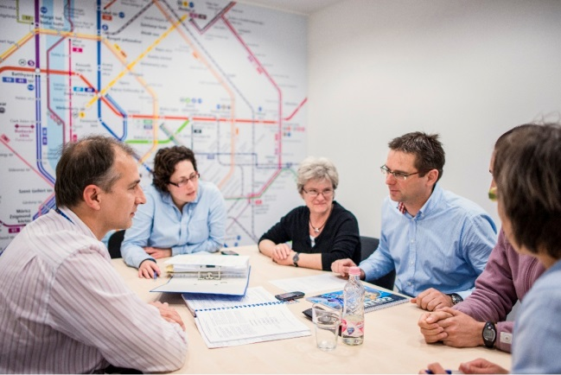
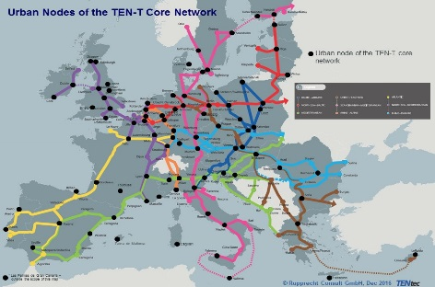
Integrated Planning – Key References
Sustainable Urban Mobility Planning (SUMP)
  Coordination of SUMP 2.0 Guideline update (2018)
  SUMP Guidelines (2013) and Glossary (2016)
  SUMP Self-Assessment tool (on www.eltis.org); update 2018
  SUMP needs assessment survey (2017)
  Guidance for key SUMP CH4LLENGEs
  SUMP Conferences Sopot 2014, Bucharest 2015 and
  Bremen 2016
  International cooperation on SUMP and
  National Urban Mobility Programmes
Governance & stakeholder cooperation
  Guidance for local SUMP processes and pilot innovations
  Moderation and facilitation of cooperation processes
Urban and regional planning
  SUMP development for regions and metropolitan areas
  Quality control of SUMP development (e.g. Vienna)
Development of Urban Nodes in the TEN-T
  Recommendations for European Commission “Improving the efficiency of urban nodes” (2016)
  Strategy for urban nodes in Germany for Federal Ministry of Transport (2017)
SUMP Guidelines and CH4LLENGE Manuals
Planning workshop, Budapest
Urban Nodes of the TEN-T Core Network, Rupprecht Consult

Slide 5
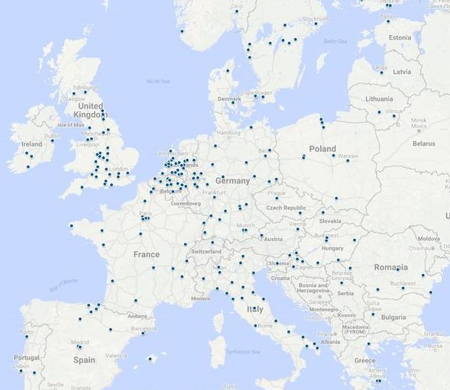
Integrated Planning – City references
Gdynia
SUMP initiation and trainings
Support of implementation and evaluation
M
SUMP-Leitlinien
SUMP-Konferenzen
Support contracts
Rostock
Electromobility strategy
Project and participation structure
Moderation
Implementation and action plan
CH4LLENGE
DYN@MO
Bielefeld
SUMP development (mobility analysis, vision and strategy)
Moderation of stakeholder participation
Charging infrastructure concept for electromobility
ELAN
Brno
SUMP initiation
Preparation participatory process
SUMP Guidelines
SUMP Conferences
SOLUTIONS
GIZ contracts
(international)
Krakow
Concept support
Aachen
SUMP initiation and trainings
Support of implementation and evaluation
Dresden
Monitoring
Evaluation concept
Self-Assessment
Kyiv, Poltava, Zhytomyr (UA)
SUMP-Beratung und Trainings
Begleitung der Umsetzung
Radverkehr, ÖPNV
Ghent
SUMP initiation and trainings
Support of implementation and evaluation
Budapest
Measure selection
Consulting process first SUMP draft
Leipzig
Integrated planning for the region
Process moderation
Vienna
Quality control
EU certification
Brasov
Quality control
Facilitation
EU certification
Trujillo, Arequipa (Peru)
SUMP-support & training
plan preparation
cycling, PT
Ljubljana
SUMP initiation and trainings
Support of implementation and evaluation
Timisoara
Initial consultation
Constanta
Quality control
Facilitation
EU certification
Latin America (Euroclima Prog)
SUMP-konwledge mgmt. support, training
Zagreb
Situation analysis
Preparation process
Koprivnica
SUMP initiation and trainings
Support of implementation and evaluation
Palma
SUMP initiation and trainings
Support of implementation and evaluation

Slide 6
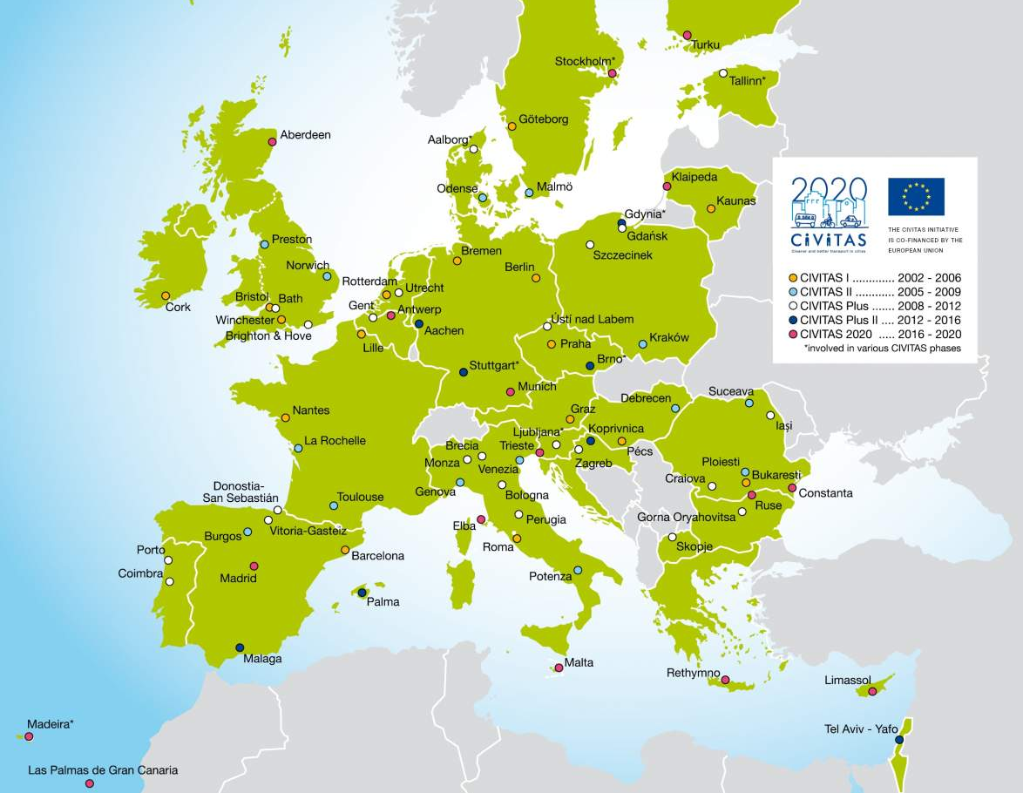
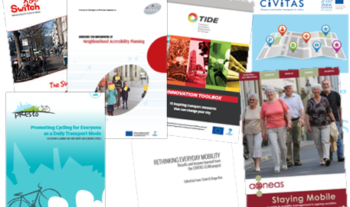
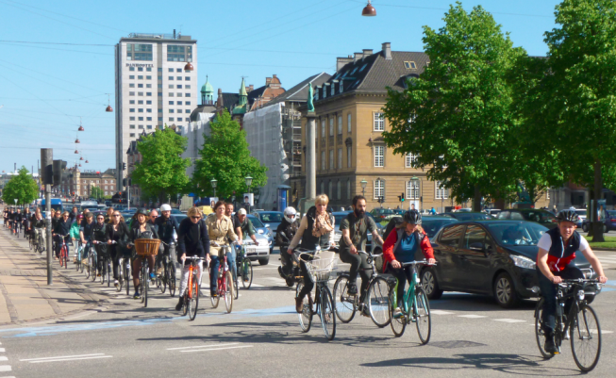
People-focussed Mobility Solutions – Key References
Integrated urban mobility approaches
  Development and management of major CIVITAS demonstration projects (CARAVEL, MOBILIS, ELAN, DYN@MO) and five support actions (active since 2001)
  Innovation Toolboxes TIDE, CIVITAS/ SUMP
  (inspiring transport measures)
  Congestion Impact Assessment Tool (FLOW)
  Promotion and take-up of innovative urban transport concepts (NICHES+)
  Fostering multimodality (BEMP, Synaptic, BAPTS )
Sustainable life styles
  Mobility management in ageing societies (AENEAS)
  “Implementing a large CarSharing scheme” (BEMP)
  Rethinking everyday mobility (ELAN)
  Social inclusion (INCLUSION)
Active mobility
  Policy guides & fact sheets on cycling promotion and pedelecs (PRESTO)
  SWITCH Campaign Guide and Toolbox
Community-based innovation
  Sustainable Neighbourhood Mobility Planning (SUNRISE)
  “Participation 2.0” (DYN@MO)
  Neighbourhood Accessibility Planning (NICHES+)
Active mobility

Slide 7
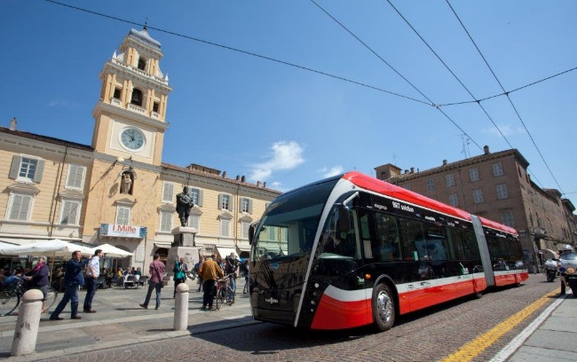
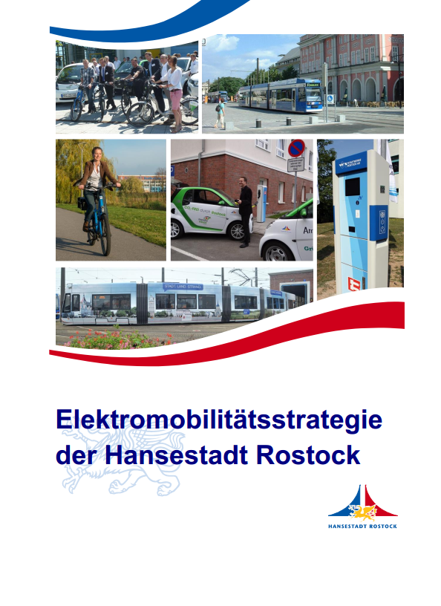
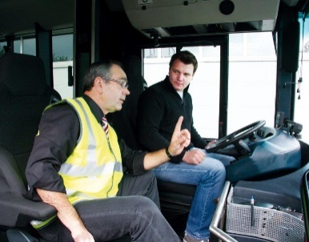


Collective and Intelligent Mobility – Key References
Public transport innovation
  Concepts and business cases for the electrification and automation of public transport
  Capacity building for public transport authorities and companies (e.g. Eco-driving for clean vehicles)
  Recommendations for public charging infrastructure at multi-modal hubs (e.g. Sustainable Transport Forum 2017)
Electromobility strategies
  Development of integrated electromobility strategies for smart cities (e.g. Rostock 2015)
  Development of concepts for multi-purpose charging infrastructure (e.g. ELIPTIC 2017)
Connected and Automated Driving
  Stakeholder consultation for EU policy development on Connected and Automated Driving (e.g. AV-ready framework)
  COST Action on automation impacts (WISE-ACT)
  Development of ITS-priorities for KfW lending portfolio
  Agenda setting and moderation of automation in cities break-out sessions at leading EU and US automation conferences
Trolley bus, Parma
E-bus driving training

Slide 8
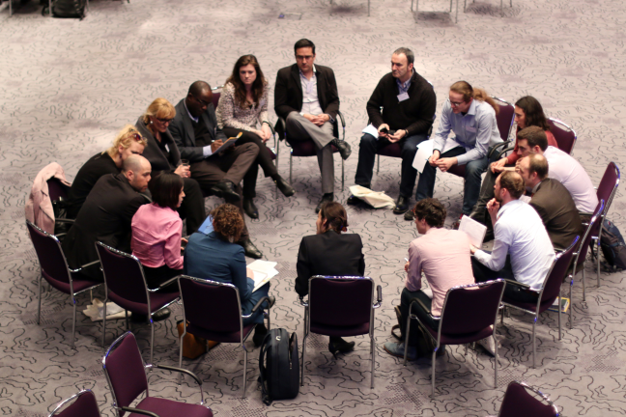
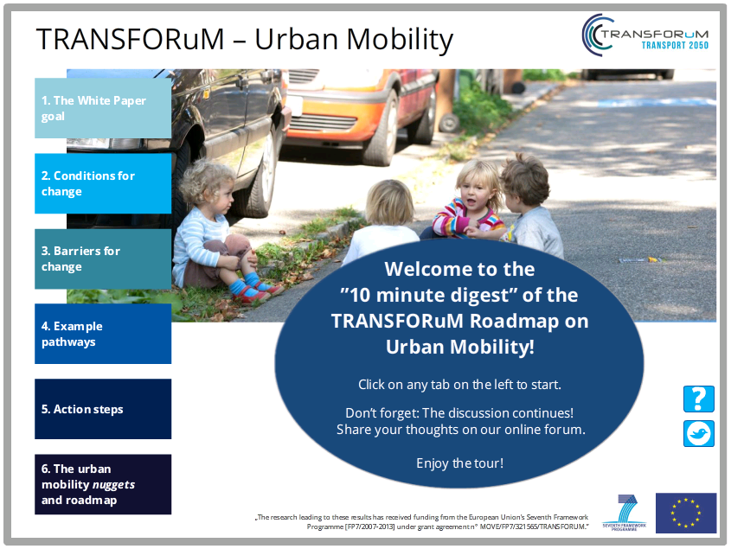
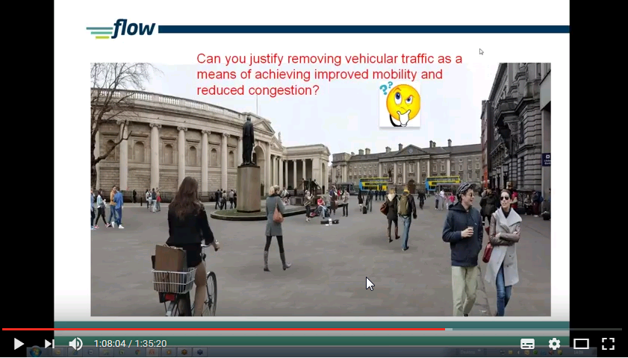

Learning and Exchange – Key references
Face-to-face learning and exchange
  Thematic workshops (e.g. series of workshops for 50 cities in TIDE project’s Circle of Innovative Cities)
  Conferences (e.g. organisation, content development and moderation of the European SUMP conferences 2014, 2015 and 2016)
  Twinning programmes for practitioners (e.g. FLOW outreach strategy: 6 partner cities, 9 exchange cities, 12 market forerunners
Interactive online learning
  Webinars (e.g. urban road automation online seminar series from September 2017)
  Moderated online courses
    CH4LLENGE e-courses on SUMP participation, evaluation, measure selection, institutional cooperation;
    SOLUTIONS international SUMP online courses;
    PRESTO e-courses on promotion of cycling in cities
    Online decision maker briefings on EU Transport White Paper Action Plans (TRANSFORuM)
Learning packages
  Series of workshop-webinar-online course packages on integrating active modes in transport modelling (FLOW) and SUMP (SUMPs-Up Learning Cities Programme)
SUMP Conference 2016 © Wolfgang Loock / Eduardo Cinta
TRANSFORuM e-course
FLOW webinar

Slide 9
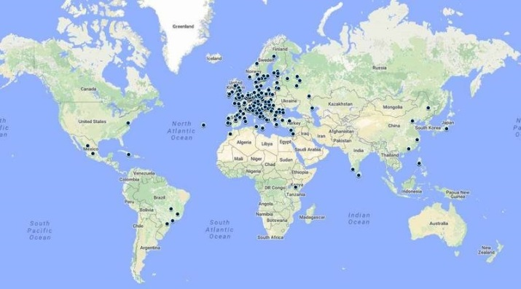
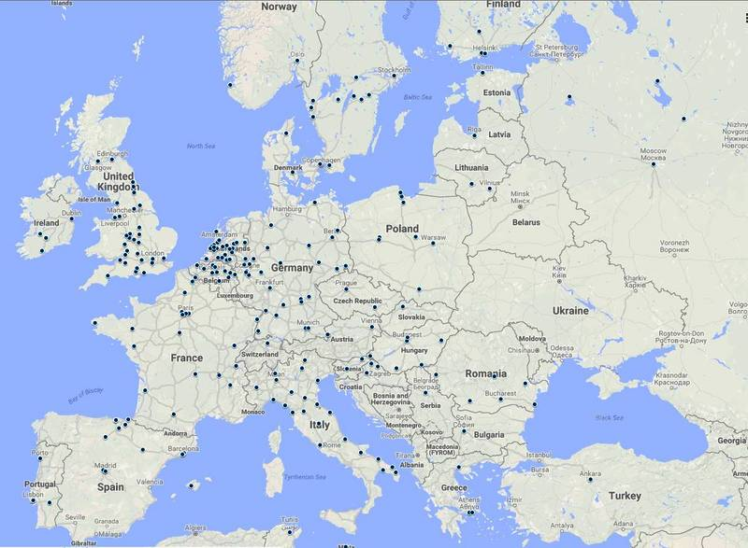
Clients & Project Partners
European Commission & other EU Institutions
  Directorates General for Transport, Research, Energy, Environment, Information Society, EASME, INEA, Joint Research Centre, European Economic and Social Cttee.
Cities & regions, public utility
& service companies
Networks and NGOs
  POLIS, UITP, FEHRL, UBC,
  Walk21, ECF, ICLEI, EMBARQ,
  Eurocities, SLoCaT, TRB
Industry
  telecom, IT industry,
  vehicle manufacturers
International organisations
  UN University, UNESCO
Research & consulting
organisations
…all over Europe and worldwide …
Network of international clients and project partners

Slide 10

International Expertise
Network of international clients and project partners
SUMP Backstopping and
Quality Control
  Peru and Ukraine (for GIZ)
  Latin America (Euroclima/ GIZ)
FUTURE-RADAR
  Capacity building of local
  stakeholders in Europe, Asia
  and Latin America on urban
  electric mobility solutions
CIVITAS SATELLITE
  International cooperation
  (China/ Asia, US/ TRB)
SOLUTIONS
  Uptake of innovative sustainable
  urban mobility solutions in Asia,
  Latin America and the Mediterranean
  Support for SUMP implementation process in Brazil
PARAMOUNT
  Urban transport workshops in Russia, China and other parts of Asia
CIVITAS CATALIST
  Expanding international alliances to increase visibility of CIVITAS (e.g. Shanghai EXPO 2010)
CABRI-VOLGA
  International cooperation on environmental risk management in the Volga basin (with UNU)

Slide 11
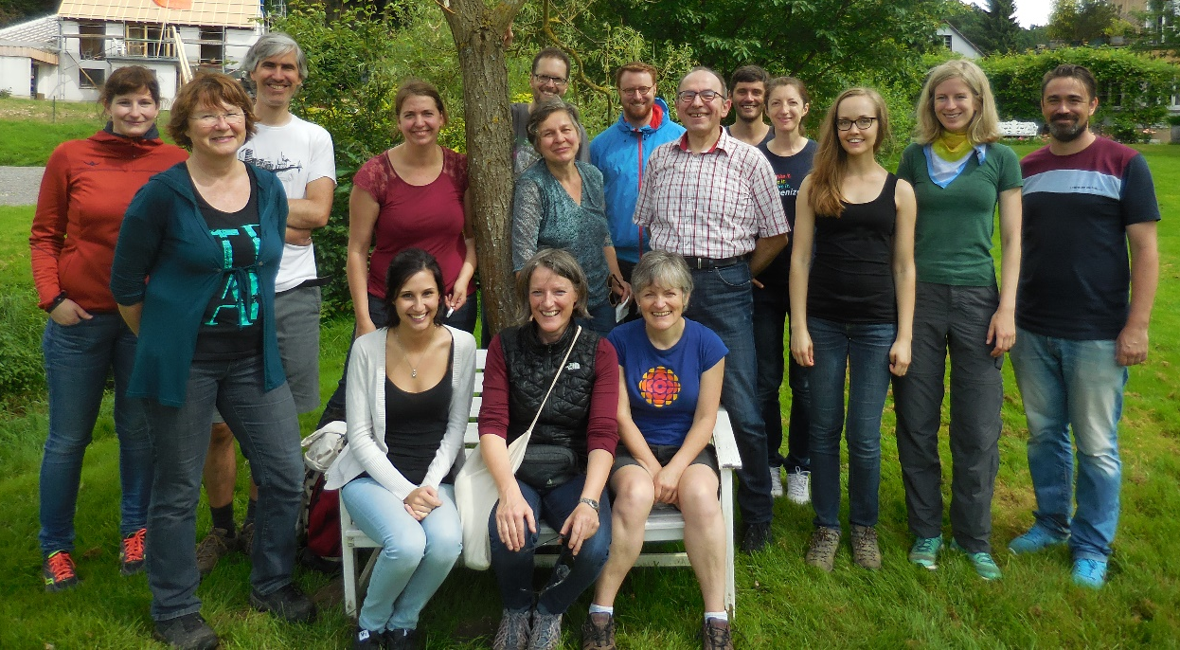
Rupprecht Consult - Who we are
An independent research and consulting company focused on sustainable development
in cities and regions
A stable company founded in 1996 successfully managing projects for over 20 years
A financially secure company with a turnover of ~1.5m€
A great team of 18 excellent
consultants
  Interdisciplinary qualifications
  in transport, urban and regional
  planning, geography, architecture,
  civil engineering, social sciences,
  sustainability science & education
  International experience with
  professionals from 7 countries
  speaking 10 languages
Company excursion to celebrate 20 year anniversary, July 2016
Notes:
Languages: English, German, French, Spanish, Italian, Romanian, Hungarian, Phillipino, Persian, Swedish, (Czech), (Russian), (Dutch)

Slide 12
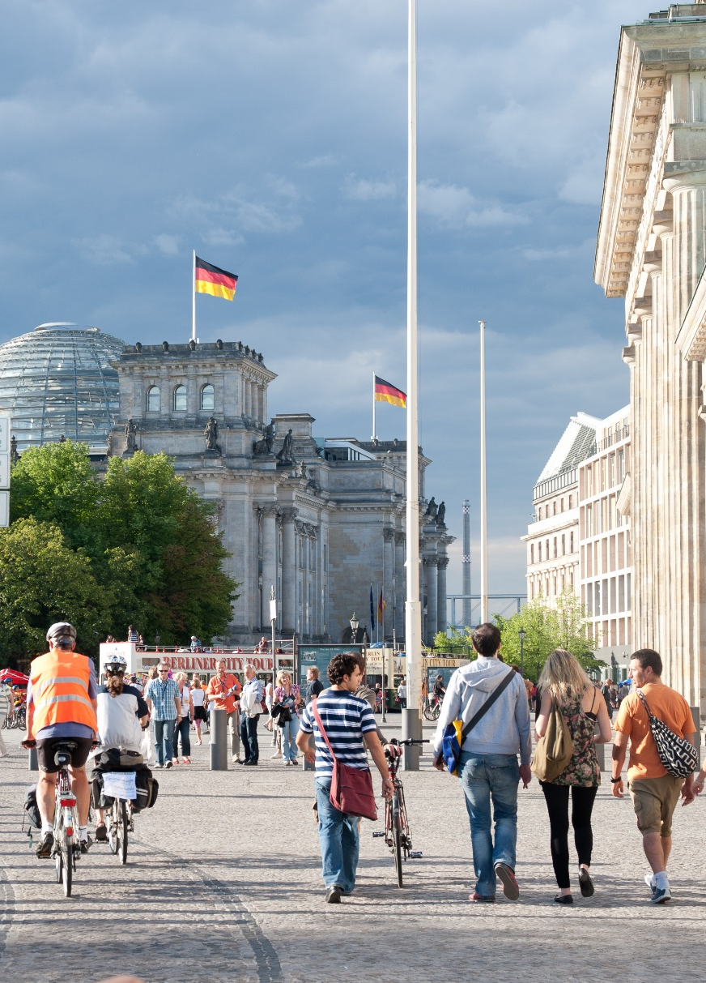
Rupprecht Consult - "Added value"
A prime knowledge partner in sustainable
urban mobility innovation
A key player in mobility planning
An expert in learning and knowledge transfer
An experienced adviser on strategic policy development
A successful developer and manager of
projects with large consortia
Well-connected and trusted in Europe and internationally
A great team of internationally experienced consultants
© Bernd Decker, Rupprecht Consult

Slide 13
Contact
Rupprecht Consult – Forschung & Beratung GmbH
Clever Str. 13 – 15, 50668 Köln (Cologne), Germany
Tel +49 221 60 60 55 - 11
s.rupprecht@rupprecht-consult.eu
www.rupprecht-consult.eu
www.mobility-academy.eu

